Slide 1
Easy PC Buy
A comparison Website of computer parts in Bangladesh

Slide 2
SRS Presentation of Software Project Lab II
Submitted by: Taslima Akbar Keya (BSSE0901)
Saif Kamal Chowdhury (BSSE0924)
Supervised by:
Md. Nurul Ahad Tawhid
Assistant Professor
Institute of Information Technology, University of Dhaka

Slide 3
Normal Requirements
Accessible via the Internet.
Allow any user to search for items.
Members will be provided with personal account .
Members & Users can show price drop section.
Restrict access to functionality of the system based upon user roles .
Allow members that log in to save products they have selected in the wishlist .
Help feature to explain what they are looking for.
Using limited budget for making the software .
Filtrated components by price and brand.

Slide 4
Expected Requirements
Error free software
Strong authentication system
User friendly
Effective system
No ambiguous feature
The system shall automatically check the product price,description.
The system shall allow the user to login based upon an assigned login id and password.
Sending notification to users if necessary.
Members can make wishlist.
Filtrated components by price and brand.
Member can write blog and can rating the website or components.

Slide 5
Exciting requirements
Payment gateway for our website.
Suggest compatible components (e.g-suggest motherboard when processor is viewed)
Suggest complete builds according to work(e.g-gaming PC,devolpoing PC)

Slide 6
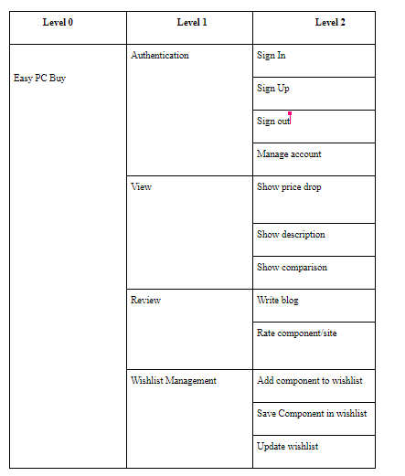
Use Case Scenario

Slide 7
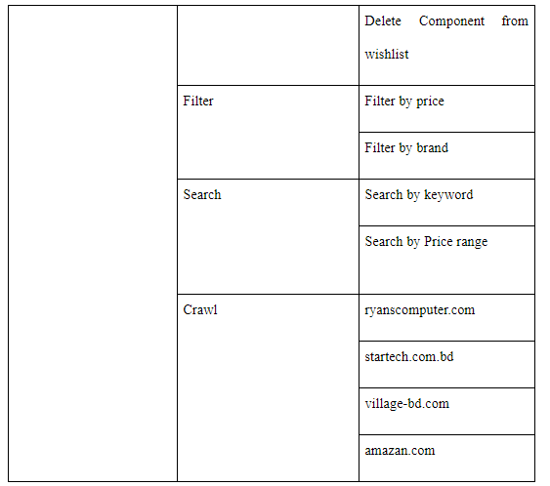

Slide 8
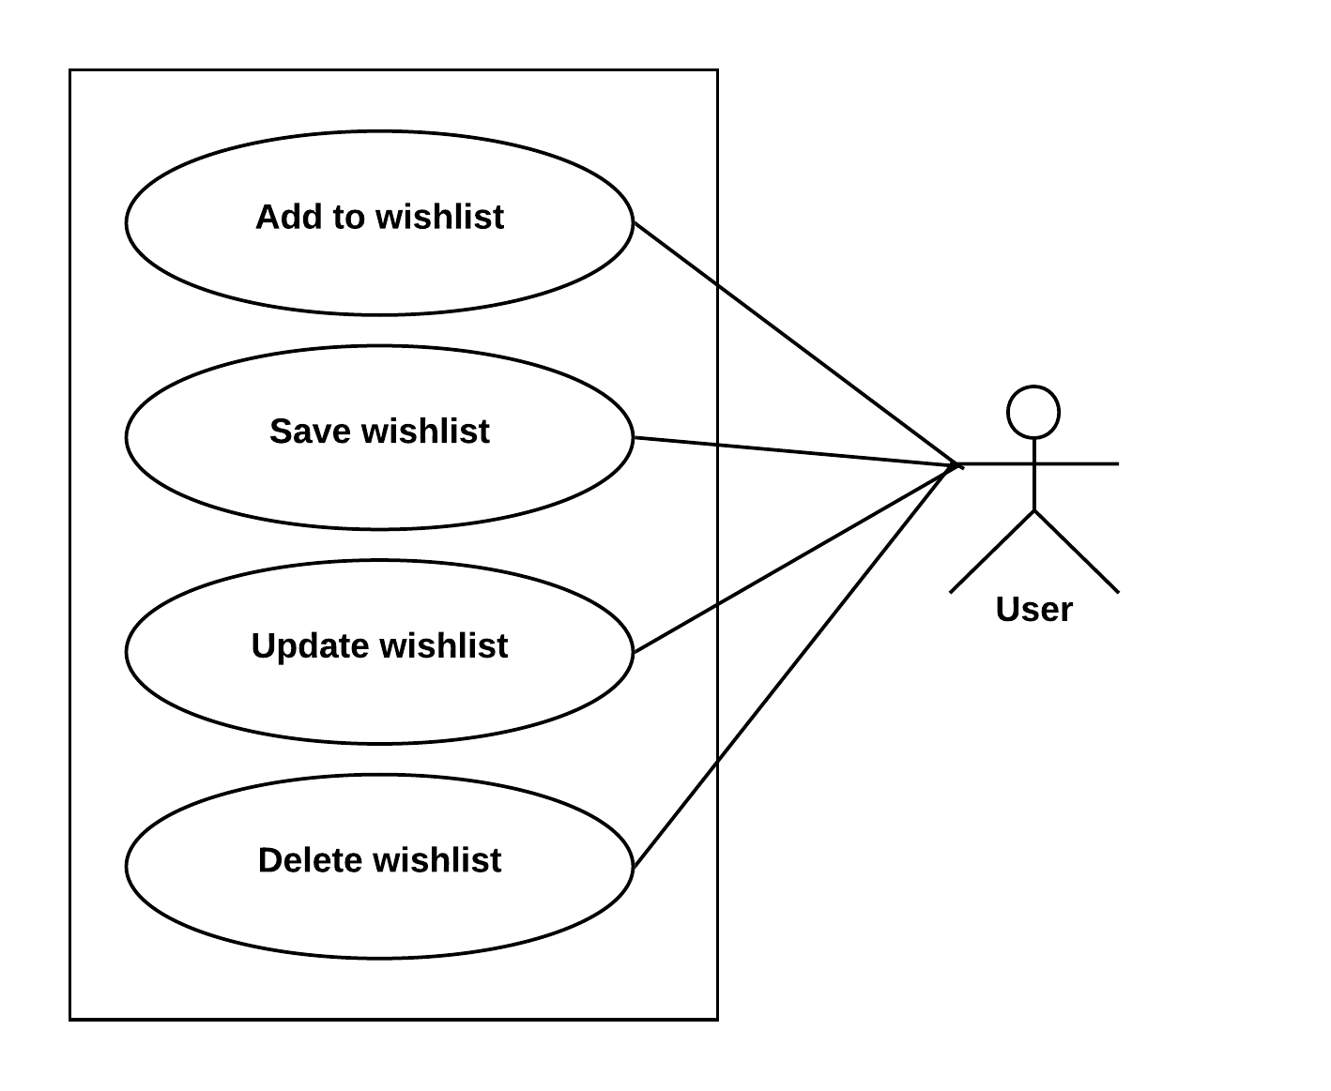
Use Case Diagram for Wishlist Management

Slide 9
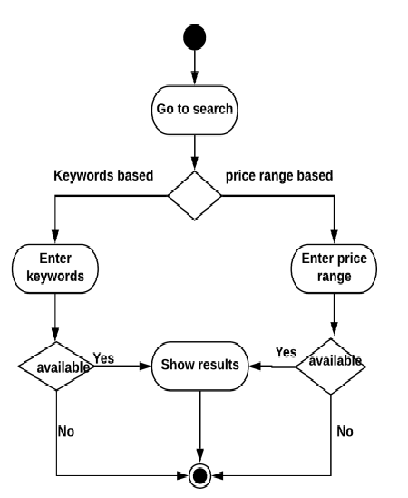
Activity Diagram for Search

Slide 10
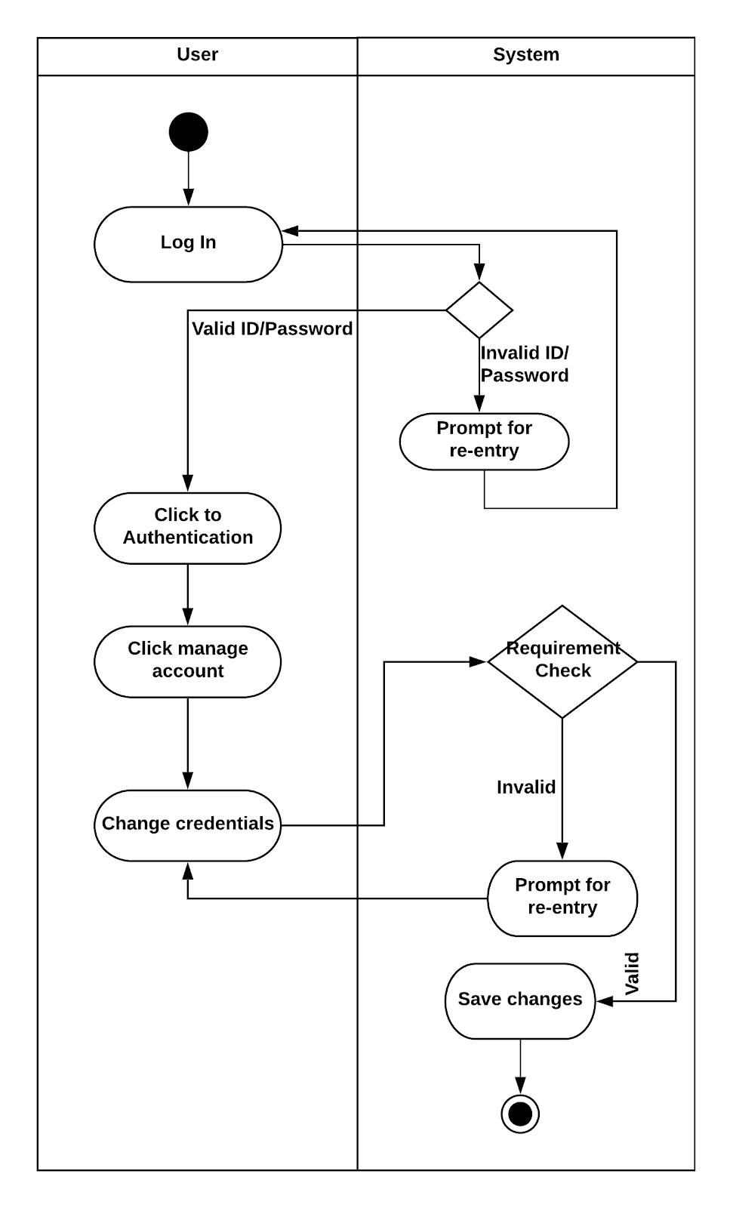
Swimlane Diagram for Account Management

Slide 11
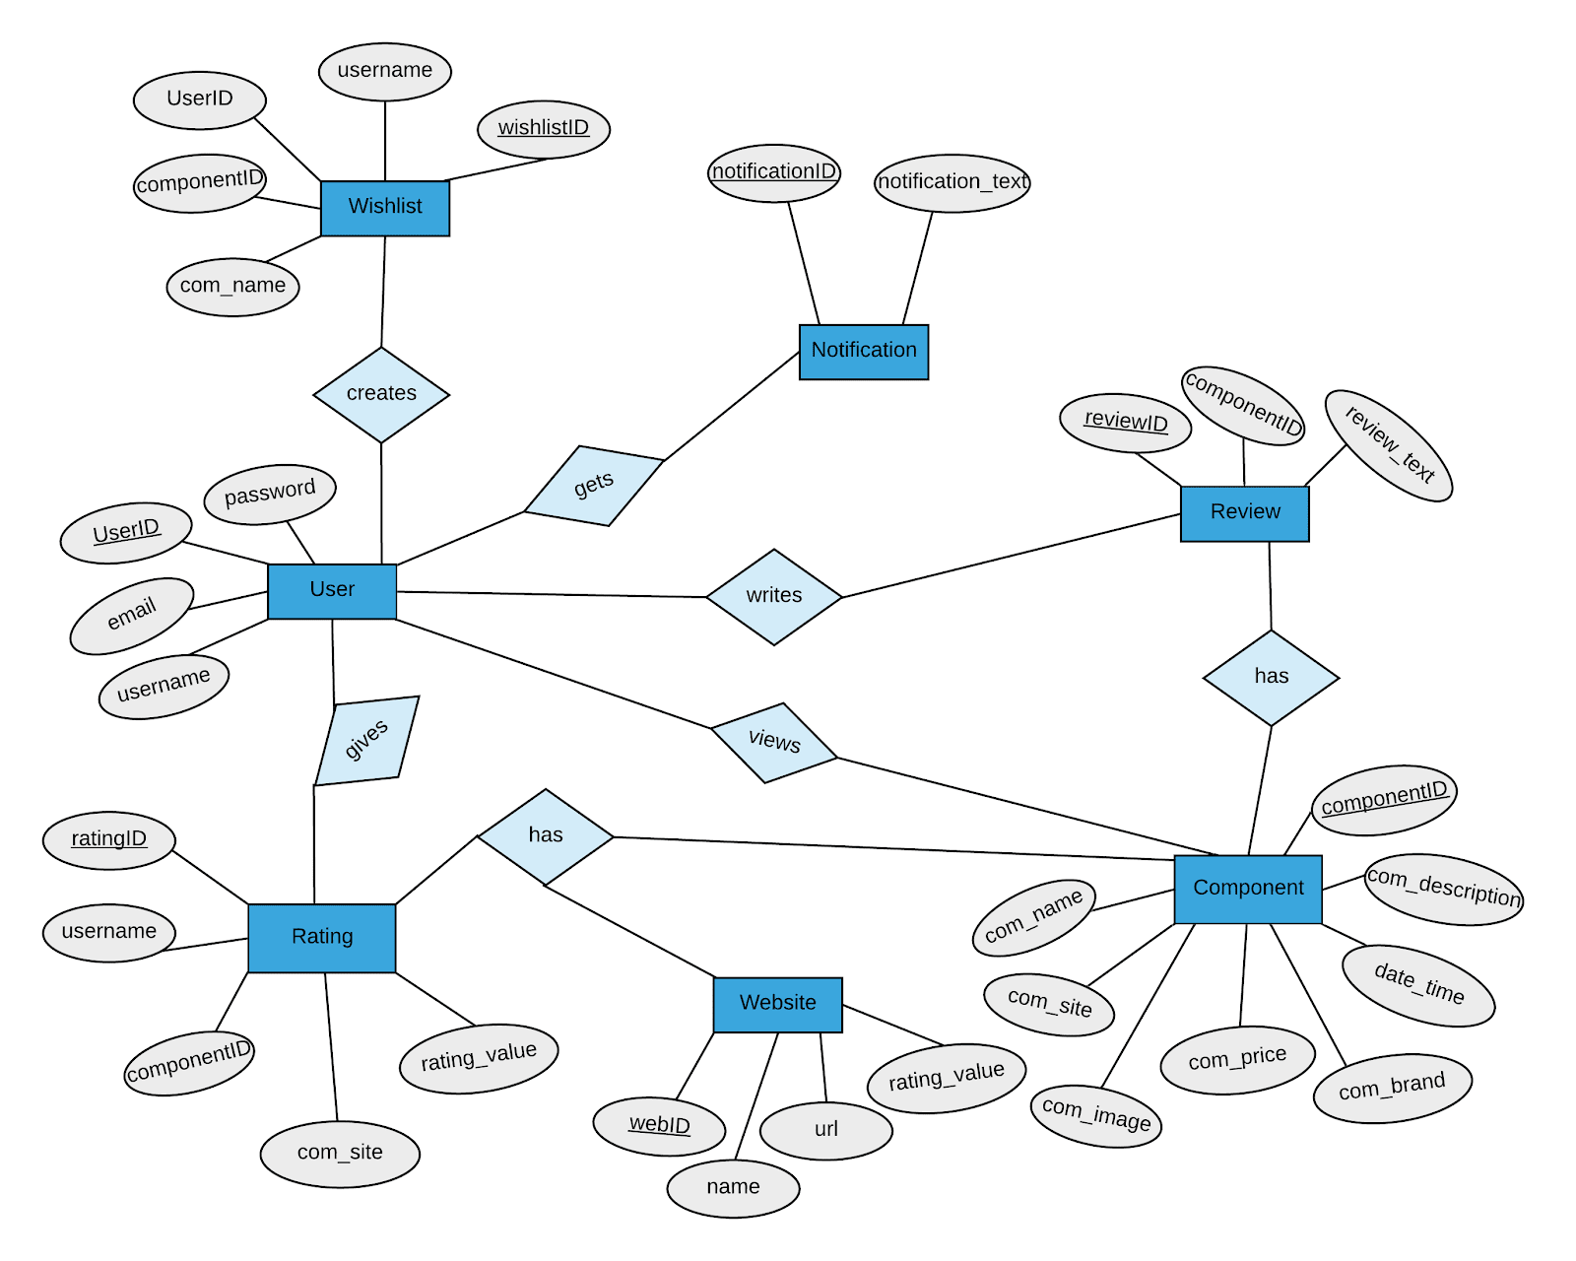
ER Diagram

Slide 12
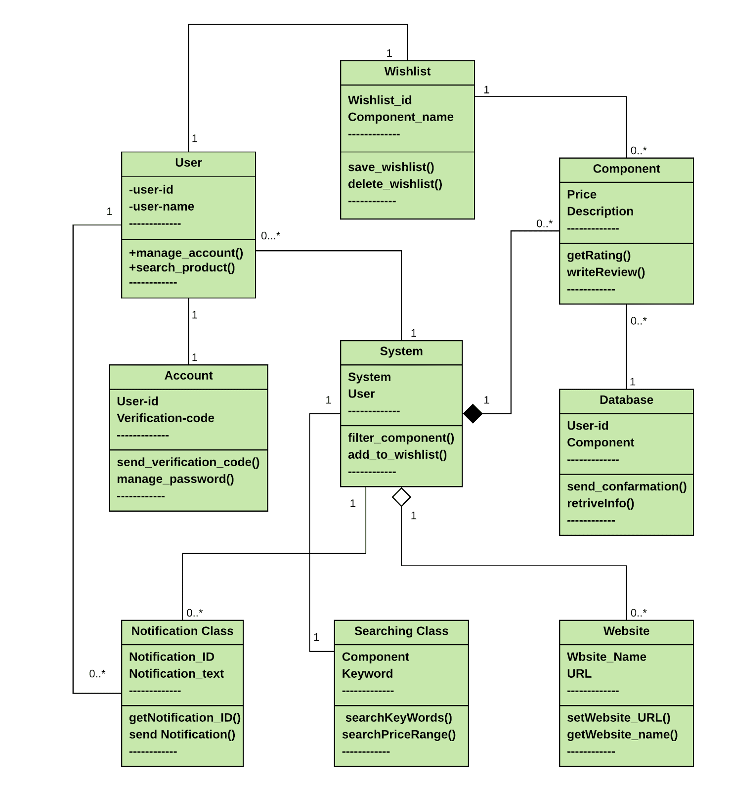
Class Diagram

Slide 13
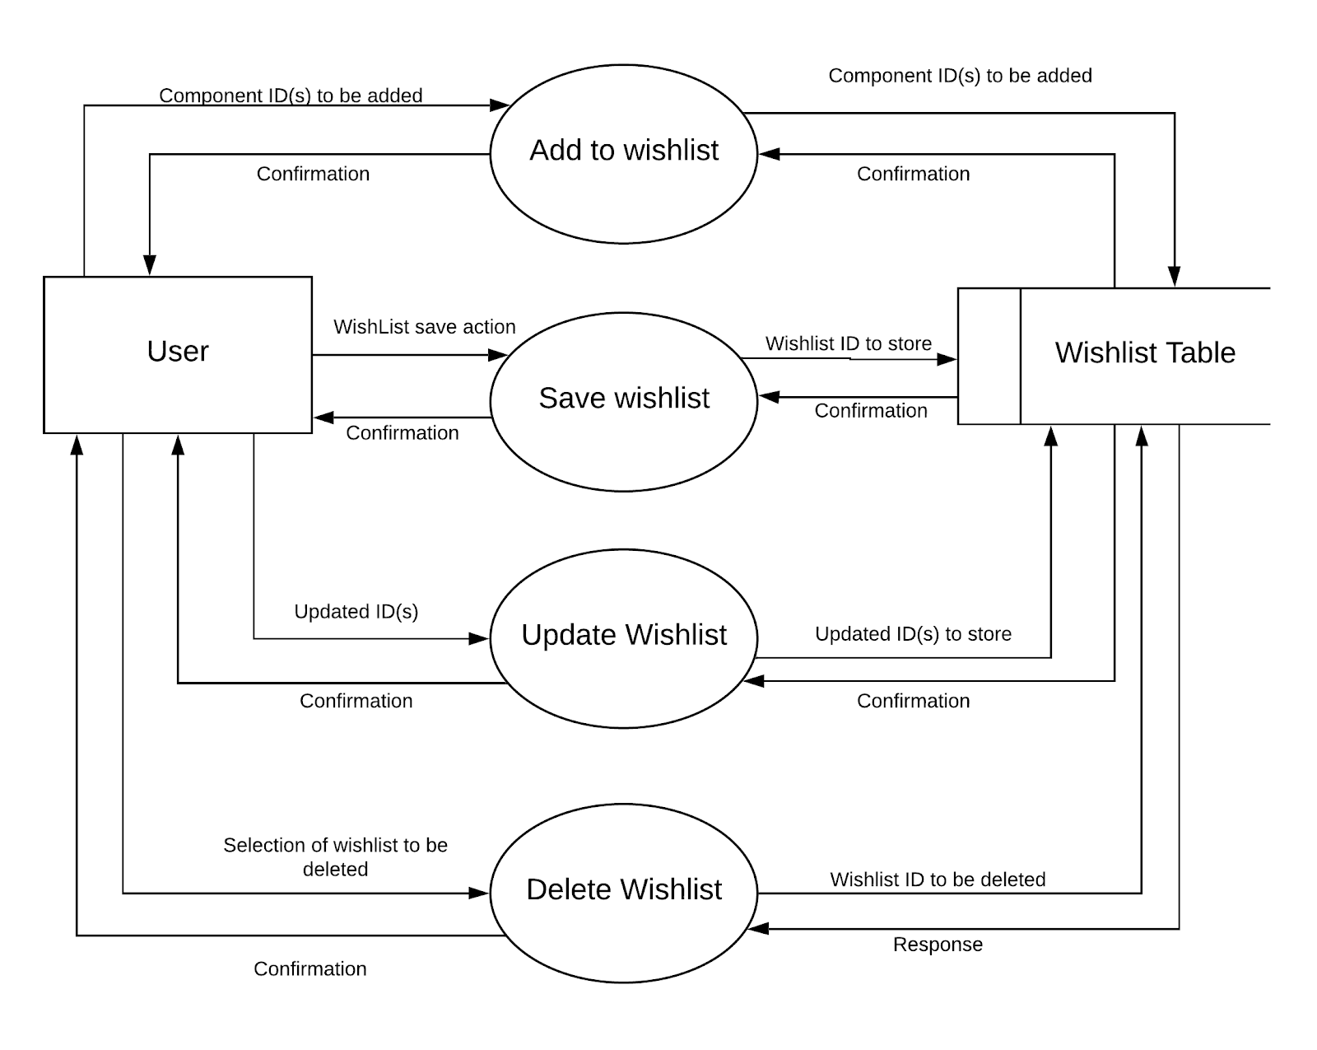
Data Flow Diagram Wishlist Management

Slide 14
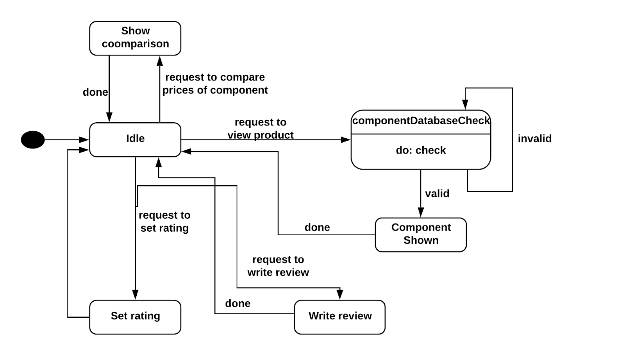
State Diagram for Component Class

Slide 15
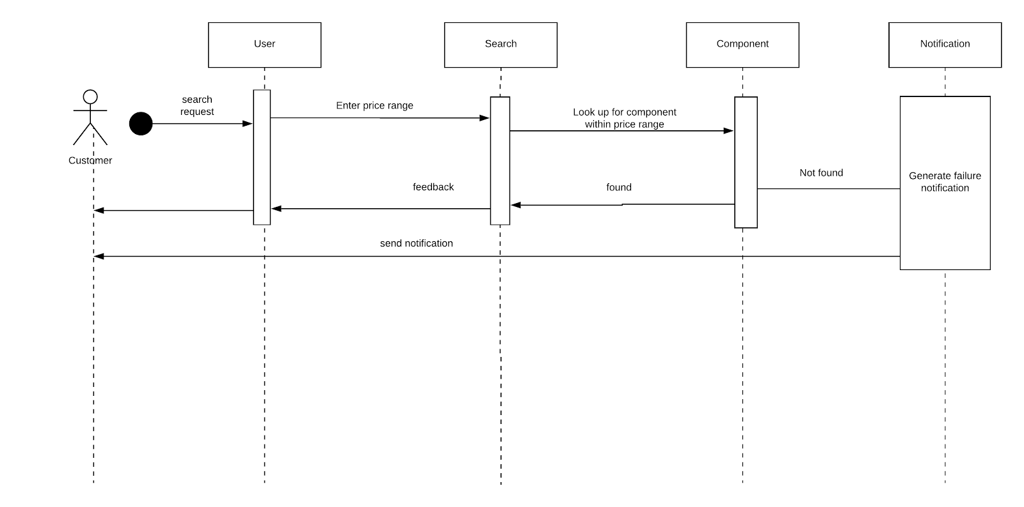
Sequence Diagram for Search by Price Range

